Slide 1
Computer Network Security
TE - IT
Lecture -18
06/09/2022
Session: 11:00 - 12:00 PM
Prof. Stella J
Department of Information Technology
Xavier Institute of Engineering

Slide 2
Module-4
Web Security Consideration
1. Secure Socket Layer Architecture / Transport Layer Security
2. HTTPS

Slide 3
Web Security
World wide web or just web is a collection of web servers that runs several websites that hold the desired information.
Mostly used Browsers: Internet Explorer, Chrome, Firefox,Safari etc

Slide 4
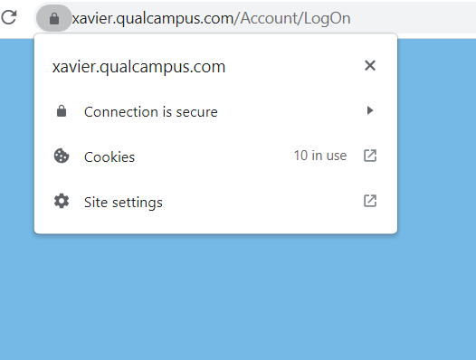
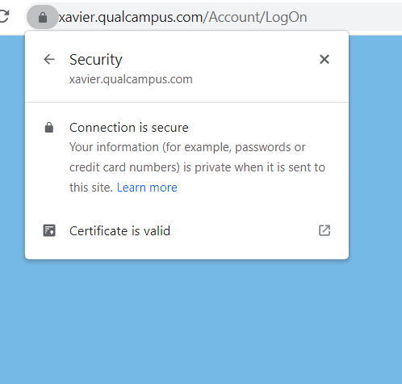
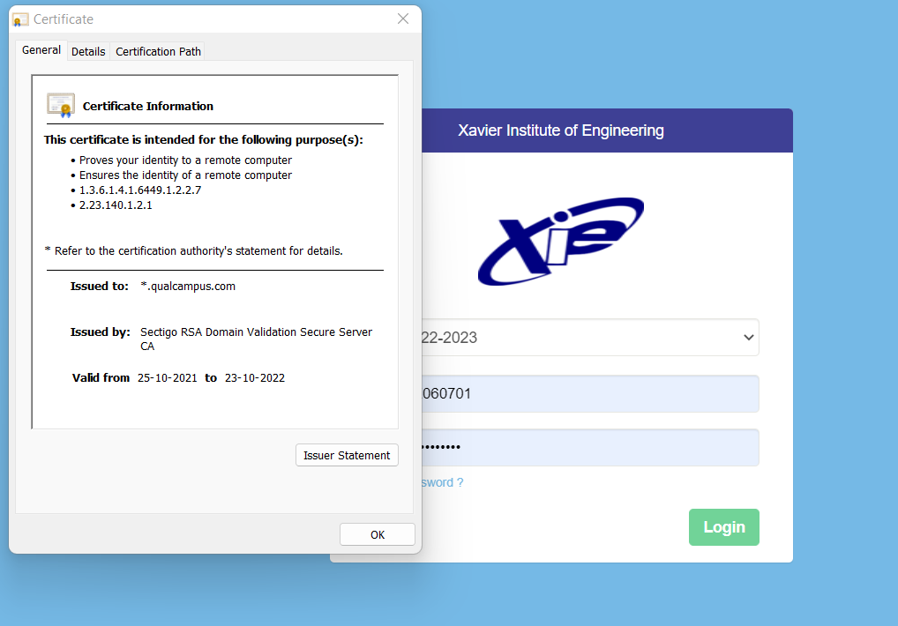

Slide 5
Secure Socket Layer
The Secure Socket Layer and Transport Layer Security are the most widely use web security protocol. It is essentially a protocol that provides a secure channel between two machines operating over the internet

Slide 6
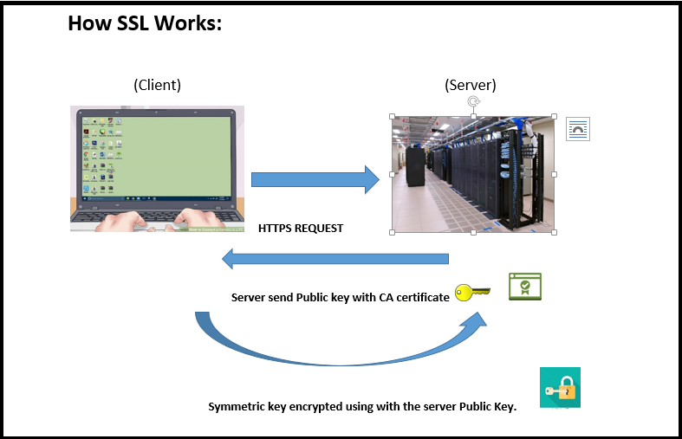
Secure Socket Layer
Def: SSL is a cryptographic protocol designed to protect communication between two entities

Slide 7
Web Security
Connection: Transport to provide the service
Connection state Parameters:
1. server and client random
2. server write MAC secret
3. client write MAC secret
4. server write key - Shared key by server
5. Intialization vector
6. Sequence number - Based on BW the data is fragmented and sent with sequence number

Slide 8
Web Security
Session: Association between client and server
Session state Parameters:
1. Session identifier
2. Peer certificate - X.509 Certificate provided by CA
3. Compression method
4. Cipher spec - Encryption & Authentication Algorithm
5. Master Secret - Secret key shared among the client & server
6. IS Resumble - Flag

Slide 9
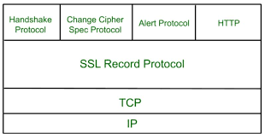
SSL Protocols
SSL uses different protocols for secure transmission of data. This works in Layers. At each layer messages may include fields for length, description, and content.
SSL takes messages to be
transmitted, fragments, compress
and applied MAC, encrypts and
transmit.
On the Rx side, It decrypt, verify,
decompress and reassembled
and then delivered to higher level clients

Slide 10
SSL Protocols
SSL uses different protocols for secure transmission of data
1. SSL Record Protocol
2. Handshake Protocol
3. Change Cipher Spec Protocol
4. Alert Protocol

Slide 11
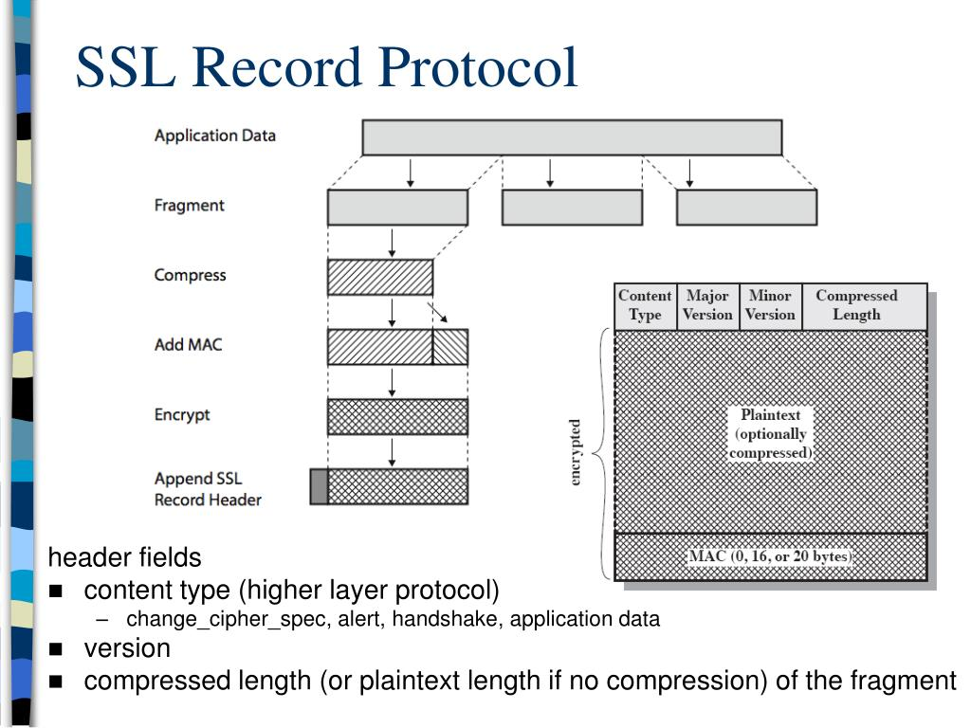
SSL Record Protocol:
The SSL Record Layer is the last protocol that receives the raw data from the higher application layers and other SSL protocols such as handshake
SSL Record Header

Slide 12
Generating MAC:
Hash(MAC_write_secret || Pad-2 || Hash(MAC_write_secret || Pad-1 || Seq_num || SSL Compressed Length || SSL Compressed Type || SSL Compressed Fragment))
Pad-2 = 0101 0110
Pad-1 = 0011 0110
48 times repeated for MD5
40 times repeated for SHA-1

Slide 13
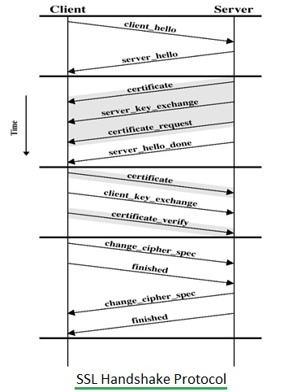
SSL Handshake Protocol:
SSL Handshake protocol allows following between client and Server. The handshake is done before any data is transmitted
• 1. to authenticate each other
• 2. to negotiate encryption and MAC algorithms
• 3. to create cryptographic keys to be used
• 4. to establish a session and then a connection
There are four phases in SSL handshake protocol. Following series of messages are used in these 4 phases.
• Phase-1: Establish Security Capabilities
• Phase-2: Server Authentication and Key Exchange
• Phase-3: Client Authentication and Key Exchange

Slide 14
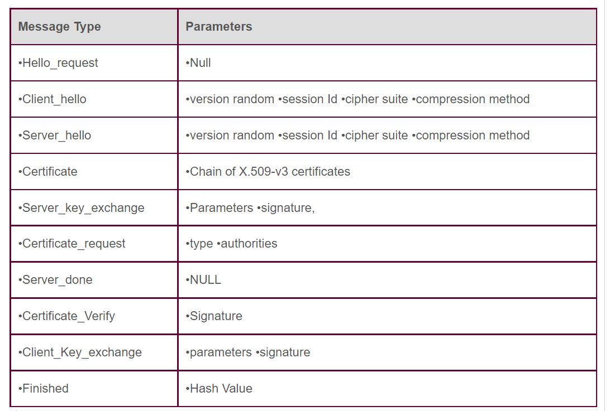
SSL Handshake Protocol:

Slide 15
SSL Handshake Protocol:
Phase#1: Establish security capabilities, including protocol version, session ID, cipher suite, compression method, and initial random numbers.
Phase#2: Server may send certificate, key exchange, and request certificate. At this stage, server signals end of the hello message phase.
Phase#3: Client transmits certificate if needed. Client transmits key exchange. Client may transmit certificate verification.
Phase#4: Change cipher suite and finish handshake protocol.

Slide 16
Change Cipher Spec Protocol:
The change cipher spec protocol notifies about the changes in cipher parameters.
It is used to change the encryption being used by the client and server.
It is a 1 Byte data tells the server about the changes need to be done in the keys
1 Byte
1
Change Cipher Spec Protocol

Slide 17
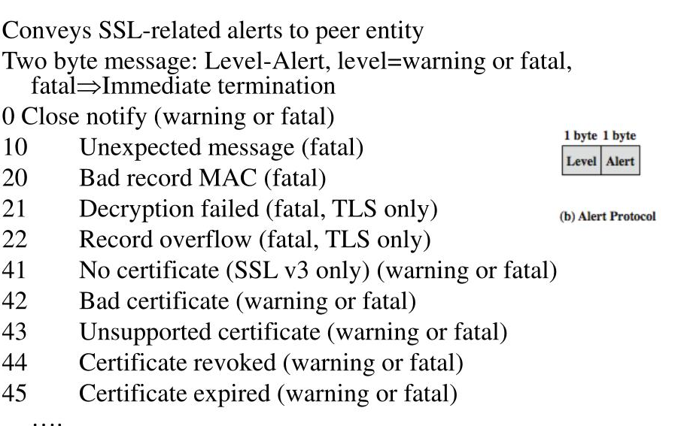
Alert Protocol:

Slide 18
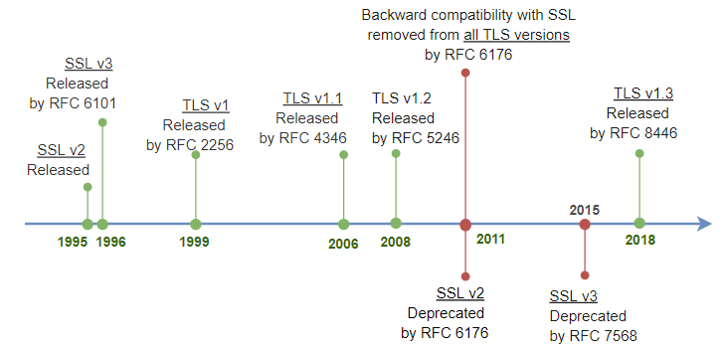
SSL Version

Slide 19
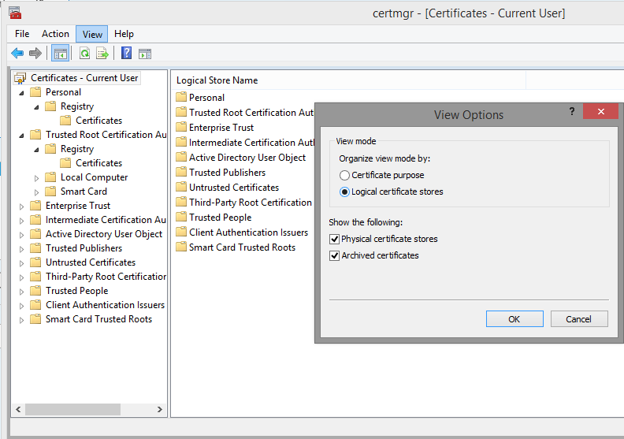

Slide 20
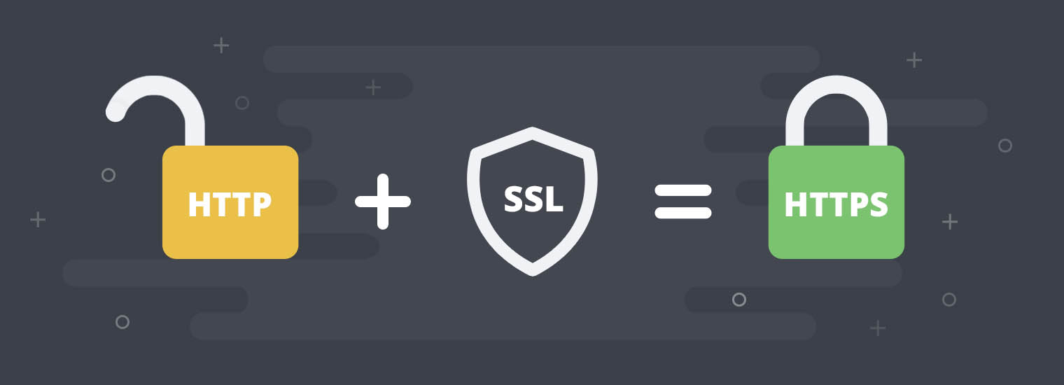
HTTPS:

Slide 21
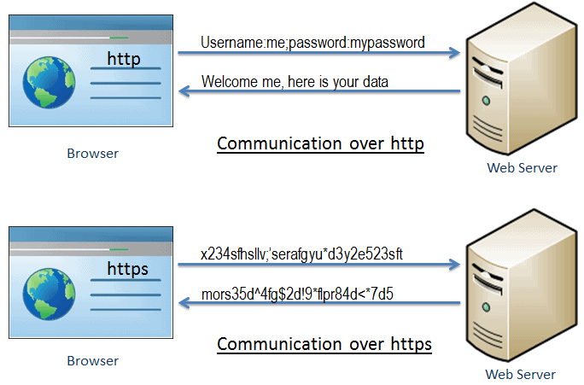
HTTPS:

Slide 22
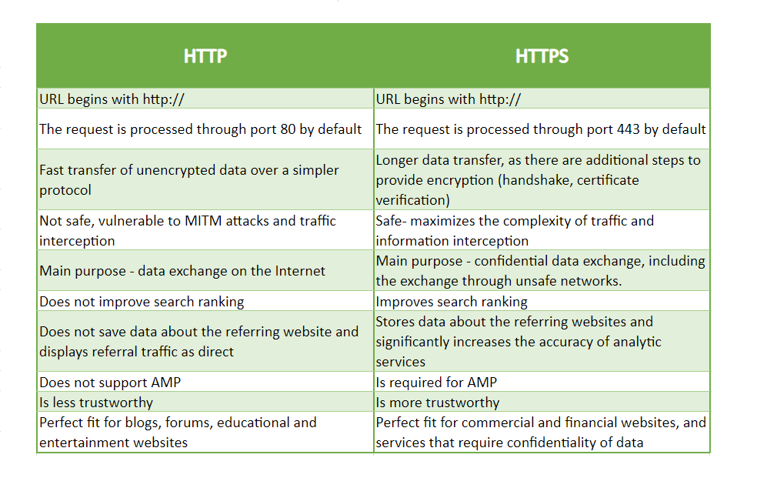
HTTP VS
HTTPS:

Slide 23
THANK YOU

